Slide 1
Firefox OS
Prepared by:
Yavor Mihaylov FN: 61528
Hristo Mohamed FN: 61498
Lachezar Tsonov FN: 61504
Georgi Antonov FN: 61499
Presentation for Operating Systems Course

Slide 2
What is Firefox OS Firefox OS (Boot to Gecko)
Mozilla's open source mobile operating system
Uses a Linux kernel
Boots into a Gecko-based runtime engine
Applications are developed entirely using : HTML, JavaScript, and other open web application APIs.
The entire user interface is a Web app
The apps don't have to reside on the device, they can "live" on the web
Users don't have to install an app to use it

Slide 3
Hardware Requirements
It should be possible to port Firefox OS to most recent ARM-based mobile devices
Firefox OS is compatible with devices including: Otoro, PandaBoard, Emulator (ARM and x86), Desktop, Nexus S, Nexus S 4G, Samsung Galaxy S II, and Galaxy Nexus, Raspbery Pi

Slide 4
Hardware Requirements
Component | Minimum | Recommended
CPU | ARMv6 | Cortex A5 class or better ARMv7a with NEON
GPU | — | Adreno 200 class or better
Connectivity | — | WiFi 3G
Sensors | — | Accelerometer Proximity Ambient light A-GPS

Slide 5
Buttons and controls
Small number of physical hardware buttons
Home button
Volume control rocker.
Power button

Slide 6
History
July 25, 2011 – announcement of the the "Boot to Gecko" Project
The goal was building a complete, standalone operating system for the open web
The announcement identified these work areas:
new web APIs
a privilege model
applications
low-level code

Slide 7
History
July 2012 – Boot to Gecko was rebranded as Firefox OS
September 2012 – forecast that Firefox OS would account for 1% of the global smartphone market in 2013
February 2013 – Plans for global commercial roll-out of Firefox OS
The first Firefox OS devices will be available in Brazil, Colombia, Hungary, Mexico, Montenegro, Poland, Serbia, Spain and Venezuela.
Electronics, ZTE, Huawei and TCL Corporation have committed to making Firefox OS devices.
At the beginning of 2013, Mozilla revealed a partnership with Spanish firm Geeksphone.

Slide 8
Demonstrations
At Mobile World Congress 2012, Mozilla demonstrated a "sneak preview" of the software and apps running on Samsung Galaxy S II phones (replacing their usual Android operating system).
In August 2012, a Nokia employee demonstrated the OS running on a Raspberry Pi.
In December 2012, Mozilla rolled out another update and released Firefox OS Simulator 1.0 - add-on for Firefox.

Slide 9
Goals
Completely open standards
A large number of established HTML5 developers.
The goal - to enable developers to build applications using WebAPI which would then run in any browser without the need to rewrite their application for each platform.
Devices will be cheaper
Firefox phones are likely to be sold first in the developing world and Eastern Europe
"The primary aim of the project is to deliver a better smartphone experience to a higher proportion of the population”
Andreas Gal

Slide 10
Firefox OS Architecture

Slide 11
Firefox OS Architecture - Terminlogy
Gaia – the user interface of b2g, written in HTML, CSS and JavaScript
Gecko – application runtime, implements Web stack
Gonk – lower-level of b2g, consist Linux kernel and HAL (libusb, BlueZ ..). Simple Linux Distribution

Slide 12
Booting
After turning on a b2g phone, execution starts on primary bootloader
From there the process is usual to Linux – bootloaders bootstrap the next loader in the chain
At the end of of the process, execution is handed off to the Linux kernel
First show splash screen
Different protocols – fastboot, odin

Slide 13
Kernel (Linux)
The Linux kernel is Gonk
Close to stock
At the end of kernel startup, a userspace “init” process is launched
After init process, Linux kernel services system calls from userspace and interrupts

Slide 14
init process
Handles mounting the require file systems
Spawns system services
After that, it stays around to serve as process manager
It interprets scripts (init*.rc files) that consists commands describing what should be done to start various services
Firefox OS init.rc is typically the stock Android init.rc

Slide 15
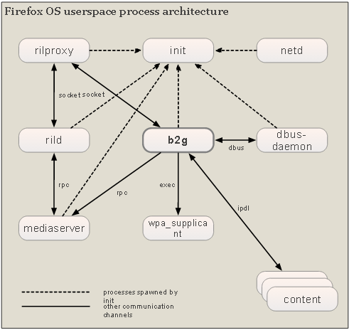
Userspace process architecture
High-level look at how the various components of Firefox OS fit together and interact with oneanother.

Slide 16
b2g
Spawn number of low-rights content processes
These processes are where web applications and content loaded.
Communicate with the main Gecko server process through IPLD, a message-passing system

Slide 17
rild
Interface to the modem processor
Daemon that implements the Radio Interface Layer (RIL).
Piece of code that's implemented by the hardware vendor to talk to their modem hardware

Slide 18
rildproxy
rild client is the rildproxy process
This acts as a forwarding proxy between rild and b2g

Slide 19
mediaserver
Controls audio and video playback
Gecko talks to it through an Android Remote Procedure Call (RPC) mechanism.
Some of the media that Gecko can play are decoded by Gecko and send directly to the mediaserver process.
Other media files are decoded by libstagefight which is capable of accessing codecs and hardware encoders

Slide 20
netid
wpa_supplicant
dbus-daemon
Used to configure network interfaces
Standart UNIX-style daemon that handles connectivity with Wi-Fi acces points
The dbus-daemon implements D-Bus, a message bus system that Firefox OS uses for Bluetooth communication

Slide 21
Gecko
Implementation of Web standardsImplement everything that user sees
Most action inside Gecko is triggered by user actions. These actions are represented by input events.
These events enter Gecko through the Gonk implementation of nslAppShell

Slide 22
Hardware Abstraction Layer
One of the porting layers of Gecko
Handles low-level access to system interfaces across multiple platforms using C++ APIs
These APIs are implemented on a per-platform basis inside the Gecko HAL itself
This hardware abstraction layer is not exposed directly to JavaScript code in Gecko

Slide 23
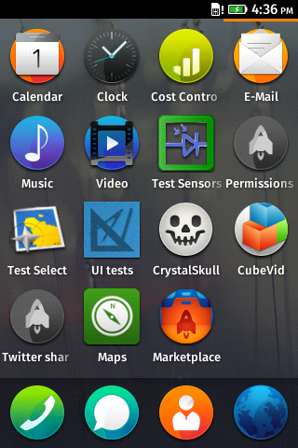
GAIA

Slide 24
Gaia
Gaia is the user interface level of Firefox OS.
Everything that appears on the screen after Firefox OS starts up is drawn by Gaia.
Gaia is written entirely in HTML, CSS, and JavaScript.
It interfaces with the operating system through Open Web APIs
Gaia can be run on other operating systems in web browsers

Slide 25
Default Interface
Similar to what you see on most typicsmartphone
The status bar at the top indicates the network, the network strength, WiFi signal strength, battery level, and current time.
The middle area - icons for the applications
Swiping left and right pages through screens of icons.
At the bottom - a dock with room for up to seven mos.
prerelease version with placeholder icons

Slide 26
Default applications
Browser
Calendar
Camera
Clock
Contacts
Dialer
Email
FM Radio
Gallery
Home Screen
Lock Screen
Marketplace
Music
PDF Viewer
Settings
SMS/MMS
Video

Slide 27
Firefox OS Applications

Slide 28
Open Web Application
What is it?
HTML+CSS+JavaScript
Isn't that PhoneGap 2.0?
Who supports it so far?

Slide 29
The OWA APIs
Geolocation
Networks (WiFi, TCP, GSM, Bluetooth...)
WebPayment
Phone operations (Power, Screen, Vibration...)
And many more
Full list at:
https://wiki.mozilla.org/WebAPI

Slide 30
Manifests
The backbone of an application
JSON
Lists the APIs you require
Portable
Full list of fields:
https://developer.mozilla.org/en-US/docs/Web/Apps/Manifest

Slide 31
Minimal manifest
{
"name": "My App",
"description": "My elevator pitch goes here",
"launch_path": "/",
"icons": {
"128": "/img/icon-128.png"
},
"developer": {
"name": "Your name or organization",
"url": "http://your-homepage-here.org"
},
"default_locale": "en"
}

Slide 32
Origins
Origin – protocol + domain + port
Manifest must have the same origin as the application
One application per origin
HTML files can come from the origin only
JavaScript, CSS or images can still come from outer sources

Slide 33
Marketplaces
Much like Google Play or Apple store
OWA standard – designed to remove restrictions from deployment
Currently: Firefox Marketplace

Slide 34
Applications

Slide 35
For Web developers
Create the application
Create a manifest
Publish the application
On your own website
At a Marketplace
Both!

Slide 36
For mobile developers
Become a web developer!
No, really, the steps are:
Use OWA technologies to develop the application
Create a manifest
Publish the application
The only difference is the change in technology stack from mobile to Open Web

Slide 37
Installing applications
Packaged
Essentially a zip with all the information
Hosted
Served from a server at a domain
Both require valid manifests
Served as .webapp and Content-Type: application/x-web-app-manifest+json

Slide 38
Deploying applications
Hosted
Server and domain – just like a normal website
Github, Heroku, Google App Engine...
Packaged
Three types: Privileged, Certified, Plain
Different permissions and review process

Slide 39
Publishing hosted applications
Submit to a Marketplace
You will still have to host it yourself for Firefox Marketplace
Publish on your own website
Requires some JavaScript to manage the installation and updates
All done using the OWA APIs

Slide 40
Publishing packaged applications
Distributed via Marketplaces
Three types:
Privileged – special review process, more security
Certified – critical system functions
Plain – some restrictions for APIs
Enforced Content Security Polices
Optional for hosted apps

Slide 41
More info
Firefox OS apps quick start
https://marketplace.firefox.com/developers/docs/quick_start
Submitting an app to Firefox Marketplace
https://developer.mozilla.org/en-US/docs/Web/Apps/Publishing/Submitting_an_app
Application submission walkthrough
http://s.vid.ly/embeded.html?link=8k2n4w&autoplay=false

Slide 42
Security

Slide 43
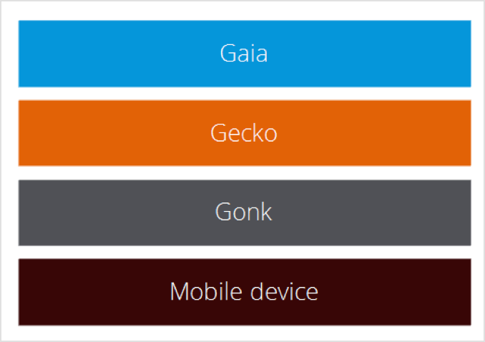
Secure Architecture

Slide 44
Secure System Deployment
The original system image is created by a known, trusted source – usually the device OEM – that is responsible for assembling, building, testing, and digitally signing the distribution package.

Slide 45
Secure System Updates
Mozilla recommends and expects that updates are fetched over an SSL connection.
Strong cryptographic verification is required before installing a firmware package.
The complete update must be downloaded in a specific and secure location before the update process begins.
The system must be in a secure state when the update process starts, with no Web apps running.
The keys must be stored in a secure location on the device

Slide 46
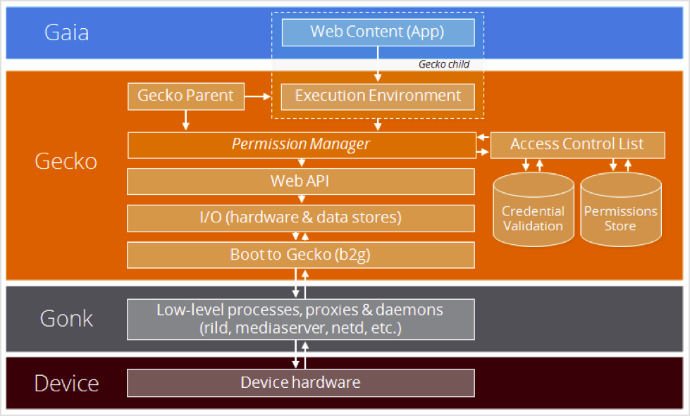
Security Infrastructure

Slide 47
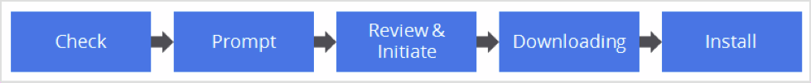
Secure App Update Process

Slide 48
Goals and scope of the Firefox OS system security model
Limit and enforce the scope of resources that can be accessed or used by a web application.
Ensure several layers of security are being correctly used in the operating system.
Limit and contain the impact of vulnerabilities caused by security bugs, from the Gonk layer.
Web application permissions and any application related security feature is detailed in the Application Security model.

Slide 49
Enforcing permissions
The Firefox OS core process, b2g, has very high privileges and has access to most hardware devices.
Web applications run in a low-privileged content process and only communicate with the b2g core process using IPC, which is implemented using IPDL.
The content process has no operating system level access to resources.
Each Web API has one or more associated IPDL protocol declaration file(s) (*.ipdl)
Firefox OS content processes can only communicate through the IPDL mechanism back to the core process, which will perform actions on behalf of content.

Slide 50
Risks
Leak of information when spawning the web application's content process
Possibility of accessing operating system resources, escalate to the same level of privileges as the b2g process
Bypassing the content process initialization

Slide 51
Secure system updates Risks
Compromised update package data, resulting in an untrusted update package being installed
Compromised update check
User does not see new updates are available
User gets an out of date package as an update, which effectively downgrades the software on the device
System state compromised or unknown during the installation of the update; this may (for example) lead to:
Missing elements during the installation, some of which may be security fixes
Security fixes reverted by the compromised system after upgrade
Vulnerabilities in the update checking mechanism running on the device
Lack of updates or tracking for a software component with a known vulnerability

Slide 52
Assumptions about users
Data transfer is slow, expensive, and intentionally constrained; in other words, we assume that the user has a slow data connection and a limited amount of traffic permitted each month.
We assume that the user has little or no access to WiFi; most updates will be performed over their cellular data connection.
Devices are rarely roaming.
Users keep their data service disabled by default, enabling it only to complete certain transactions.
Users keep and use multiple SIM cards.

Slide 53
Design principles
Updates should minimize impact to the user; don't interrupt the user any more than necessary, don't adversely impact their connection speed, and so forth.
Don't charge the user to update their apps.
Minimize the consequences of failed updates.
Support backward compatibility for users who can't update their apps, or aren't able to update them often.
Avoid presenting users with unneccessary technical details.

